Slide 1
Fake News Detection
Submitted in the partial fulfillment for the award of the degree of
BACHELOR OF ENGINEERING
IN
BIG DATA ANALYTICS
Submitted by:
Prince Kumar 20BCS3936
Rishab Kumar 20BCS3973
Under the Supervision of:
Sukhman Kaur
Department of AIT-CSE
DISCOVER . LEARN . EMPOWER

Slide 2
Outline
Introduction to Project
Problem Formulation
Objectives of the work
Methodology used
Results and Outputs
Conclusion
Future Scope
References

Slide 3
Introduction
With a lot of information or news, the one question occurred whether the given news or information is True or Fake.
Fake news is commonly distributed with an intent to mislead or make an inclination to get political or monetary benefits.
Let’s consider the example - In the recent elections of India, there has been a lot of discussion in regards to the credibility of different news reports preferring certain applicants and the political thought processes behind them.
In this growing interest, exposing fake news is paramount in preventing its negative impact on people and society.

Slide 4
Introduction(Cont.)
The algorithms used by fake news detection systems include machine learning algorithms such as Logistic Regression, Random Forests, Decision trees.
A simple method of fake news detection based on one of the AI algorithms called the Naive Bayes classifier help to examine how this particular method works for the particular problem with a manually labeled (fake or real) dataset and to support the idea of using machine learning to detect fake news.

Slide 5
Problem Formulation
The majority of people search and consume news from social media rather than traditional news organizations these days.
On one side, where social media have become a powerful source of information and bringing people together, on the other side it also 1 put a negative impact on society.
Look at some examples herewith; Facebook Inc’s popular messaging service, WhatsApp became a political battle-platform in Brazil’s election.
False rumours, manipulated photos, de-contextualized videos, and audio jokes were used for campaigning. These kinds of stuff went viral on the digital platform without monitoring their origin or reach

Slide 6
Problem Formulation(Cont.)
Fake news identification on social media faces several challenges. Firstly, it is difficult to collect fake news data.
Furthermore, it is difficult to label fake news manually. Since they are intentionally written to mislead readers, it is difficult to detect them simply based on news content.
Furthermore, Facebook, Whatsapp, and Twitter are closed messaging apps. The misinformation disseminated by trusted news outlets or their friends and family is therefore difficult to be considered as fake.

Slide 7
Objectives of the Work
Finding datasets containing both fake and real news alongwith their marker.
Model development and training on the datasets.
Model validation to improve the accuracy.
Creation of the web interface to deploy the model on the internet i.e., Create a Flask APP and a virtual environment.
Deployment of the model on the internet

Slide 8
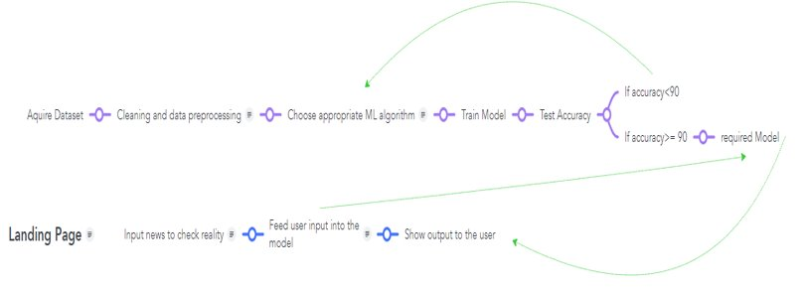
Methodology used

Slide 9
Methodology(Cont.)
Data Loading: We are loading a CSV file for the data sorting and training testing part of the model. ​
Vectorization: Vectorization is needed for determining the frequency of the words present in a passage. This is needed to determine which words are used often. ​
Classifier: Machine learning algorithm which can be used for binary text classification​
Model Building: The model is built through the train and test of the dataset, by ensuring that the training is done for 80% of the dataset and testing is done in the rest of the 20% of the dataset.

Slide 10
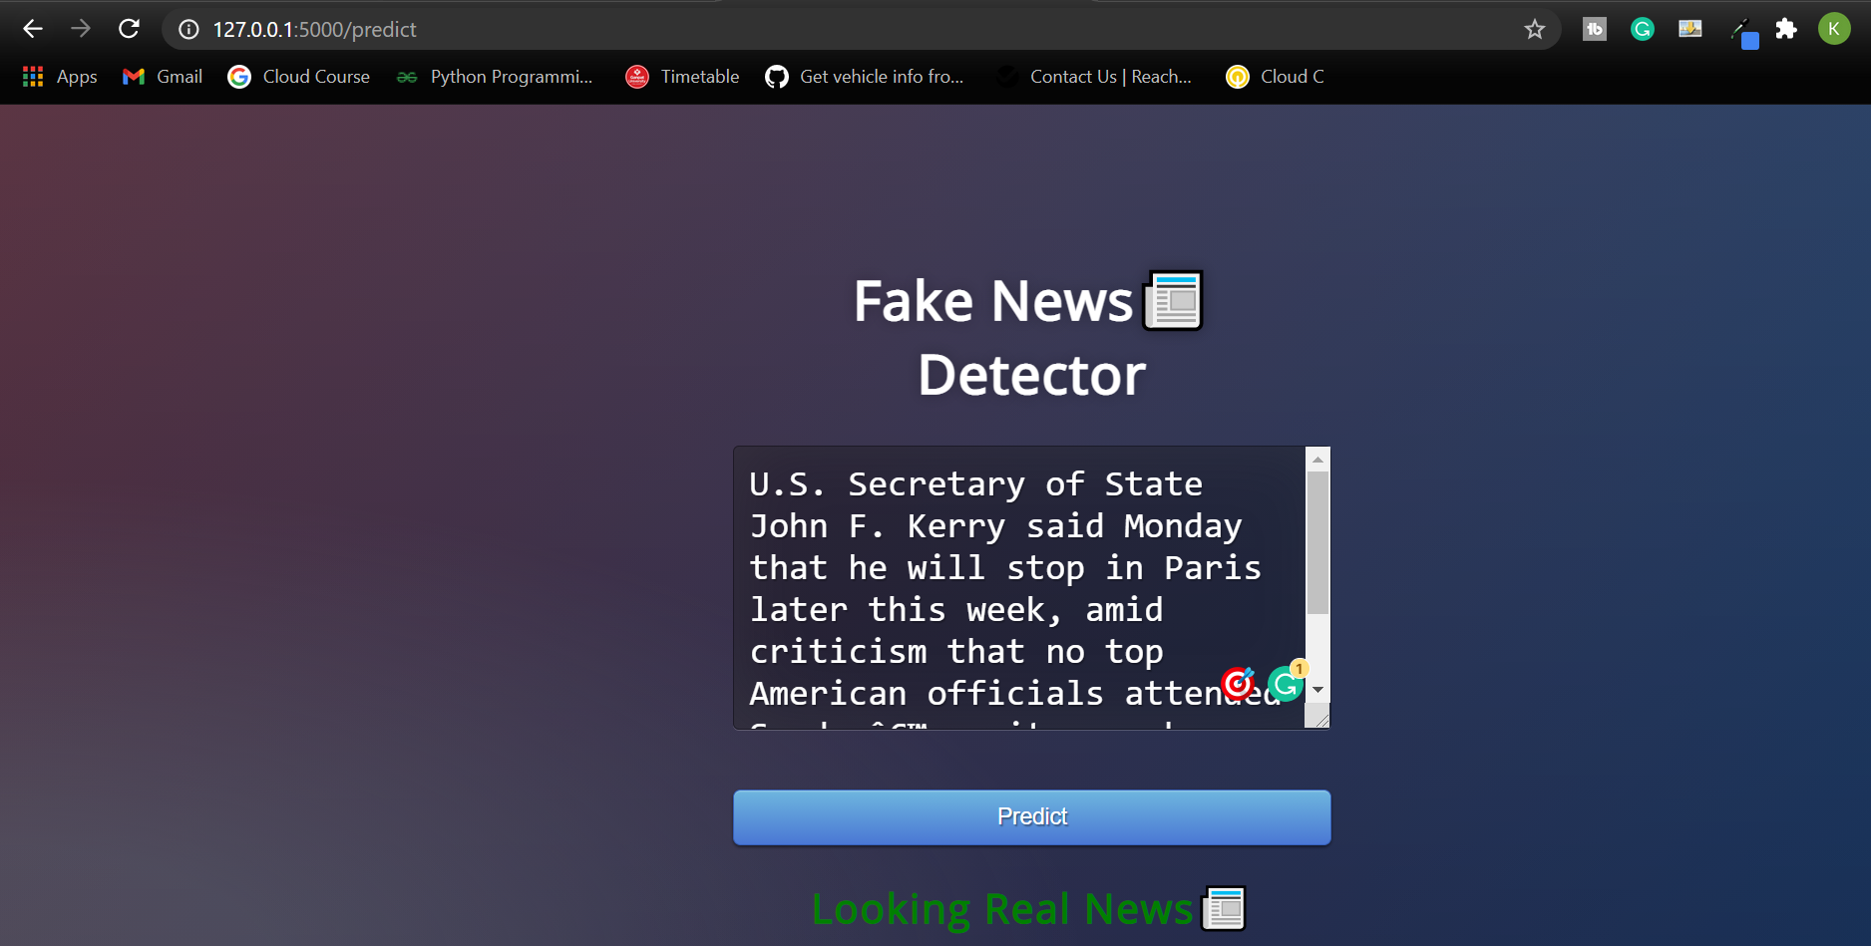
Results and Outputs

Slide 11
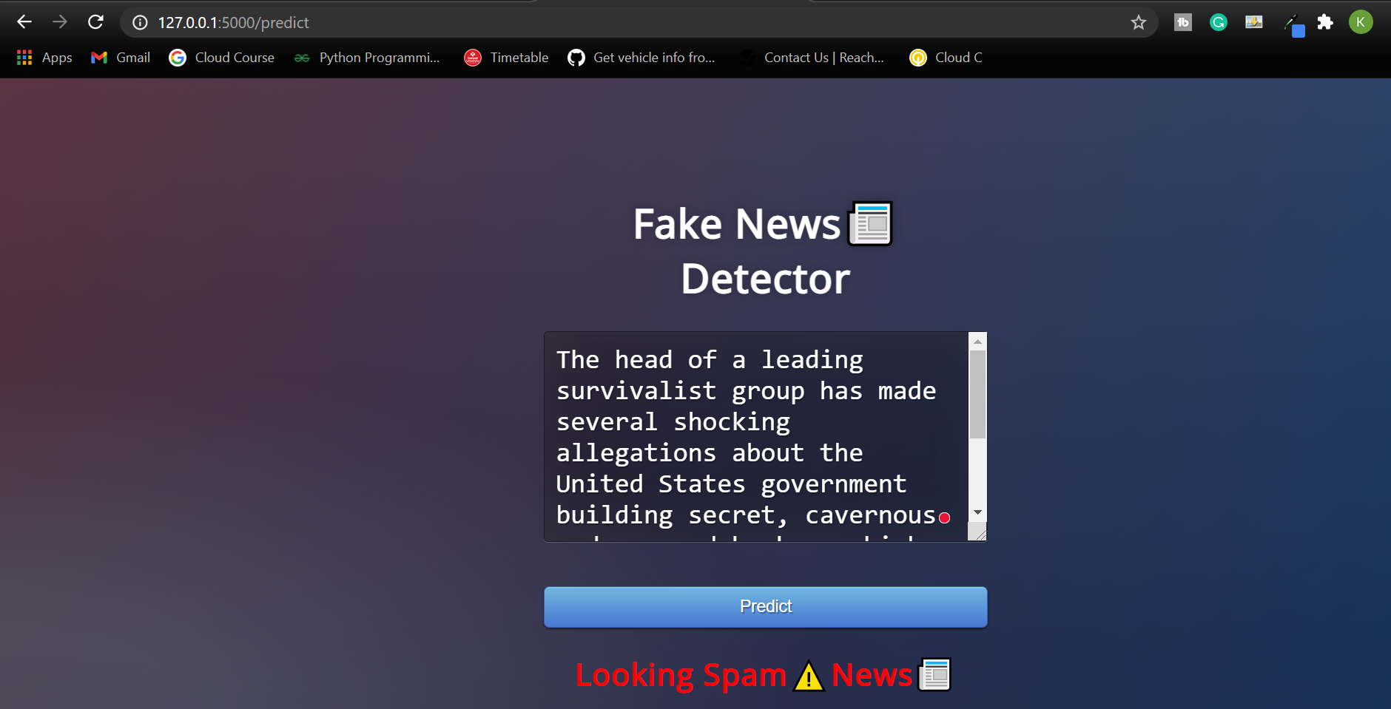
Results and Outputs

Slide 12
Conclusion
In this project, we find the solution for the fake news detection problem using the machine learning approach.
We observed that the Random Forests algorithm with a simple term frequency-inverse document frequency vector gives the best output compares to others.
We examined various text properties that can be used to distinguish fake and real content, and we trained a combination of different machine learning algorithms using these properties.

Slide 13
Future Scope
Even though this project is useful, but in order to produce a progressive complete end to end solution.
We are required to represent for tougher cases where reliable sources and authors are responsible for releasing fake news.
Blacklisting the unreliable sources or marking their content unreliable.
Train Model with accurate data to cater misinformation disseminated by trusted news outlets or friends and family

Slide 14
References
S. Gilda, "Notice of Violation of IEEE Publication Principles: Evaluating machine learning algorithms for fake news detection," 2017 IEEE 15th Student Conference on Research and Development (SCOReD), 2017, pp. 110-115, DOI: 10.1109/SCORED.2017.8305411.
M. Granik and V. Mesyura, "Fake news detection using naive Bayes classifier," 2017 IEEE First Ukraine Conference on Electrical and Computer Engineering (UKRCON), 2017, pp. 900-903, DOI: 10.1109/UKRCON.2017.8100379.
Shu, K., Sliva, A., Wang, S., Tang, J., & Liu, H. (n.d.)."fake news detection on social media: A data Mining Perspective".
[4] S. B. Parikh and P. K. Atrey, "Media-Rich Fake News Detection: A Survey," 2018 IEEE Conference on Multimedia Information Processing and Retrieval (MIPR), 2018, pp. 436- 441, DOI: 10.1109/MIPR.2018.00093.
C. Buntain and J. Golbeck, "Automatically Identifying Fake News in Popular Twitter Threads," 2017 IEEE International Conference on Smart Cloud (SmartCloud), 2017, pp. 208-215, DOI: 10.1109/SmartCloud.2017.40.

Slide 15
References(Cont.)
A. Gupta and R. Kaushal, "Improving spam detection in Online Social Networks," 2015 International Conference on Cognitive Computing and Information Processing(CCIP), 2015, pp. 1-6, DOI: 10.1109/CCIP.2015.7100738.
M. L. Della Vedova, E. Tacchini, S. Moret, G. Ballarin, M. DiPierro, and L. de Alfaro, "Automatic Online Fake News detection Combining Content and Social Signals," 2018 22nd Conference of Open Innovations Association (FRUCT), 2018, pp. 272-279, DOI: 10.23919/FRUCT.2018.8468301.
De Beer, Dylan, and Machdel Matthee. “Approaches to Identify Fake News: A Systematic Literature Review.” Integrated Science in Digital Age 2020 vol. 136 13–22. 5 May. 2020, doi:10.1007/978-3-030-49264-9_2
S. I. Manzoor, J. Singla, and Nikita, "Fake News Detection Using Machine Learning approaches A Systematic Review," 2019 3rd International Conference on Trends in Electronics and Informatics (ICOEI), 2019, pp. 230-234, DOI: 10.1109/ICOEI.2019.8862770.

Slide 16


